Slide 1
Impressions of Light
Using Intentional Camera Movement

Slide 2
Seeking new creative inspiration…
JMW Turner
Light, movement, atmosphere
Snow Storm 1842
Monet and the Impressionists
Changing quality of light and emotion
Houses of Parliament 1905

Slide 3
Seeking new creative inspiration…
William Neill
Use of intentional camera movement using a single exposure and slow shutter speed to create impressionistic photographs.
https://www.outdoorphotographer.com/pro-perspectives/william-neill/impressions-of-autumn/
Rob Friel ARPS
Discussion of ARPS panel
https://www.youtube.com/watch?v=sIOD7JdePqU
Polina Plotnikova FRPS
ICM and multiple exposures to create sense of movement
https://www.polinaplotnikova.com/dancing-flowers

Slide 4
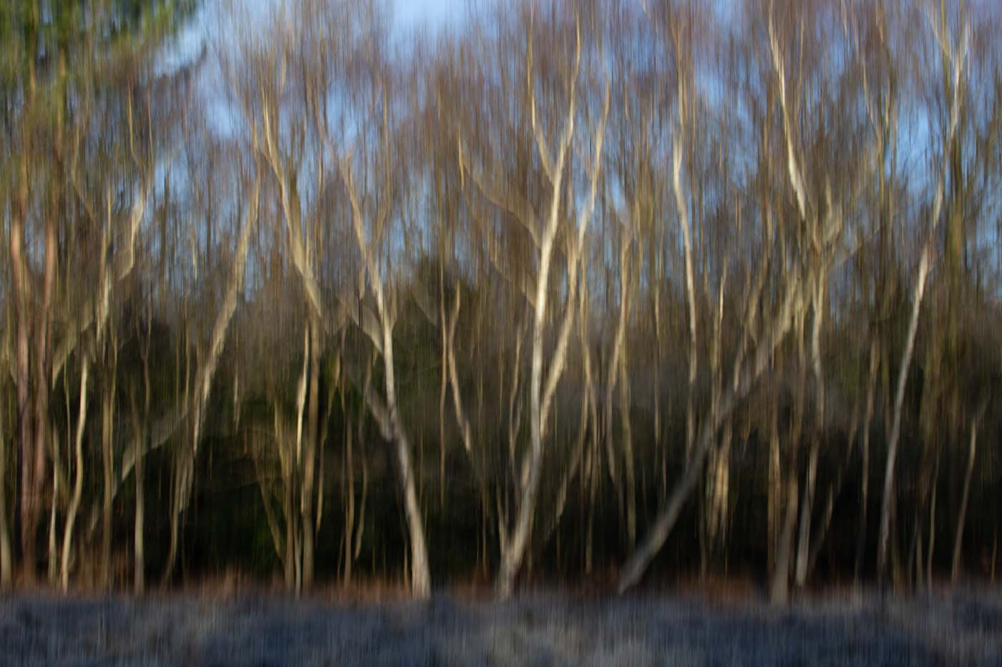
Winter – Petts Wood (ISO 100, F18 and 1/30th sec)

Slide 5
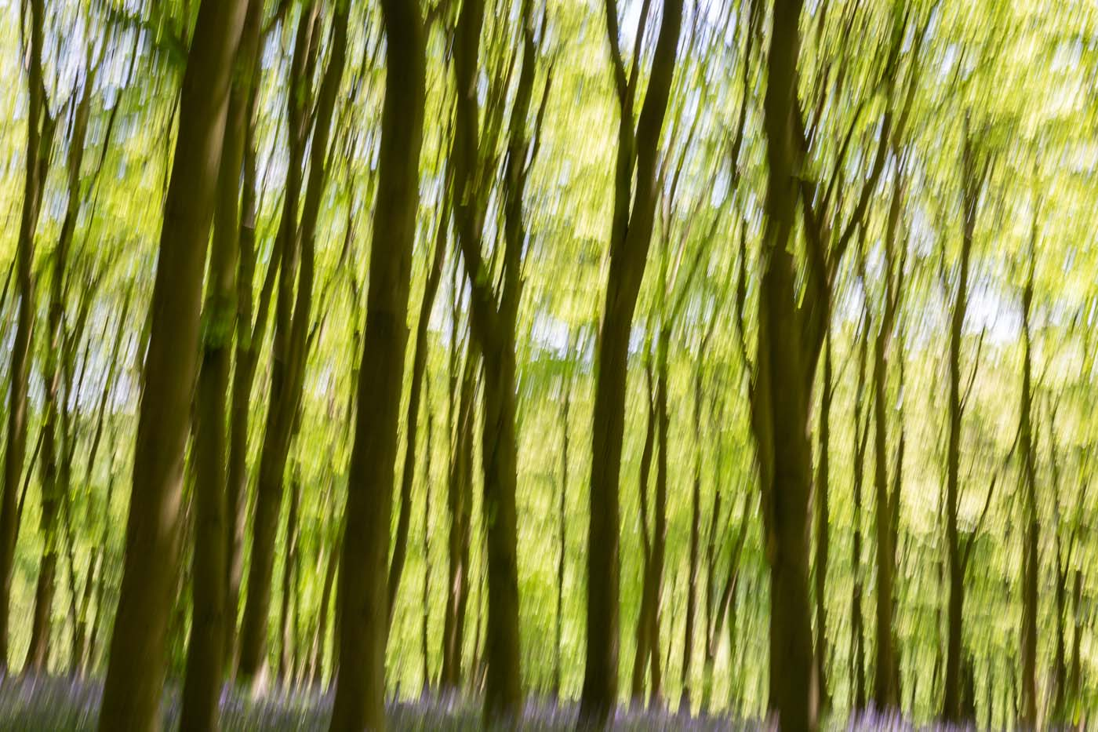
Spring – Andrews Wood (ISO 100, F10 and 1/20th sec)

Slide 6
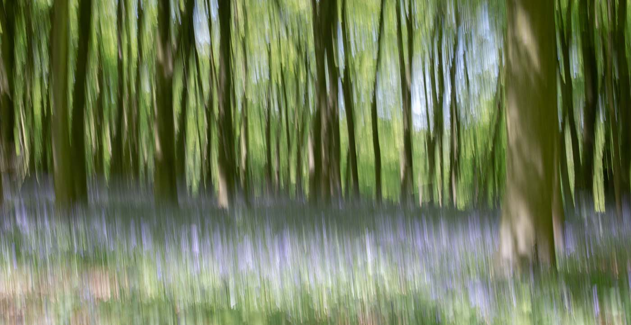
Spring – Andrews Wood (ISO 100, F10 and 1/8th sec)

Slide 7
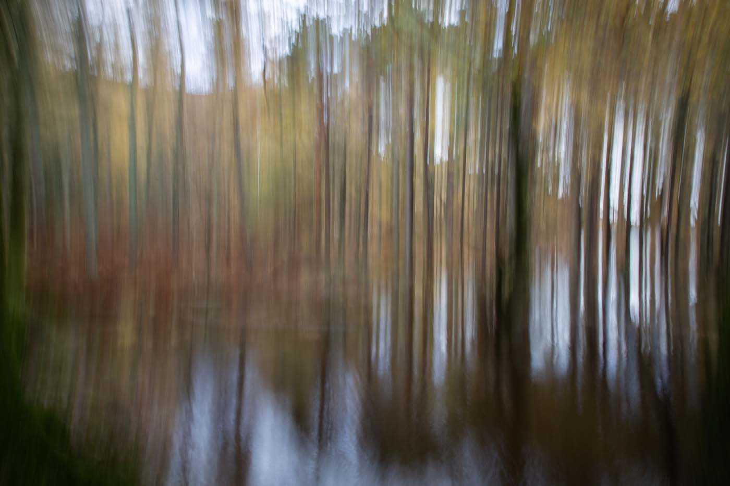
Autumn – Derwent Water (ISO 100, F22 and 1.3 sec)

Slide 8
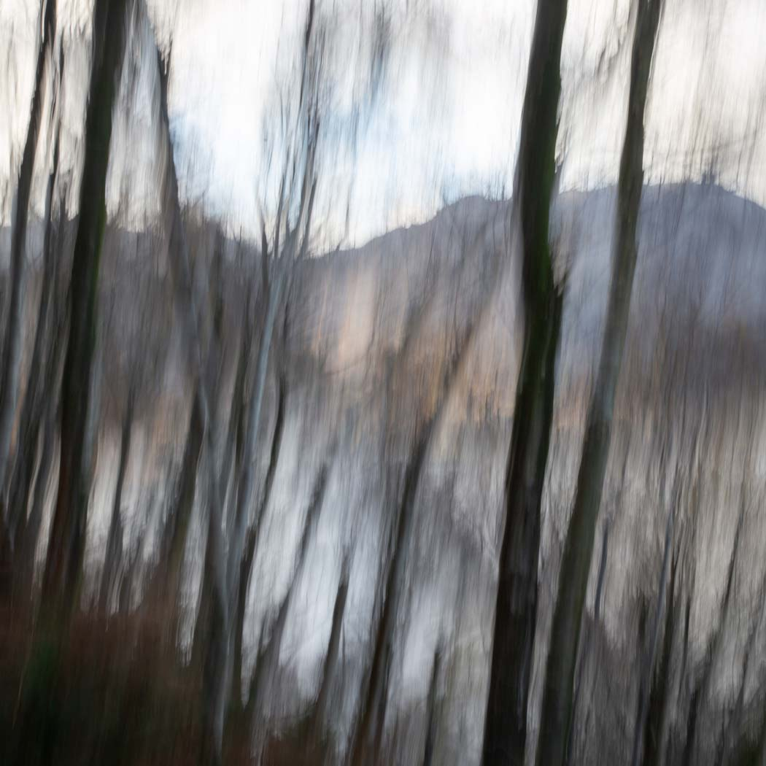
Autumn – Ullswater Water (ISO 100, F22 and 1/5th sec)

Slide 9
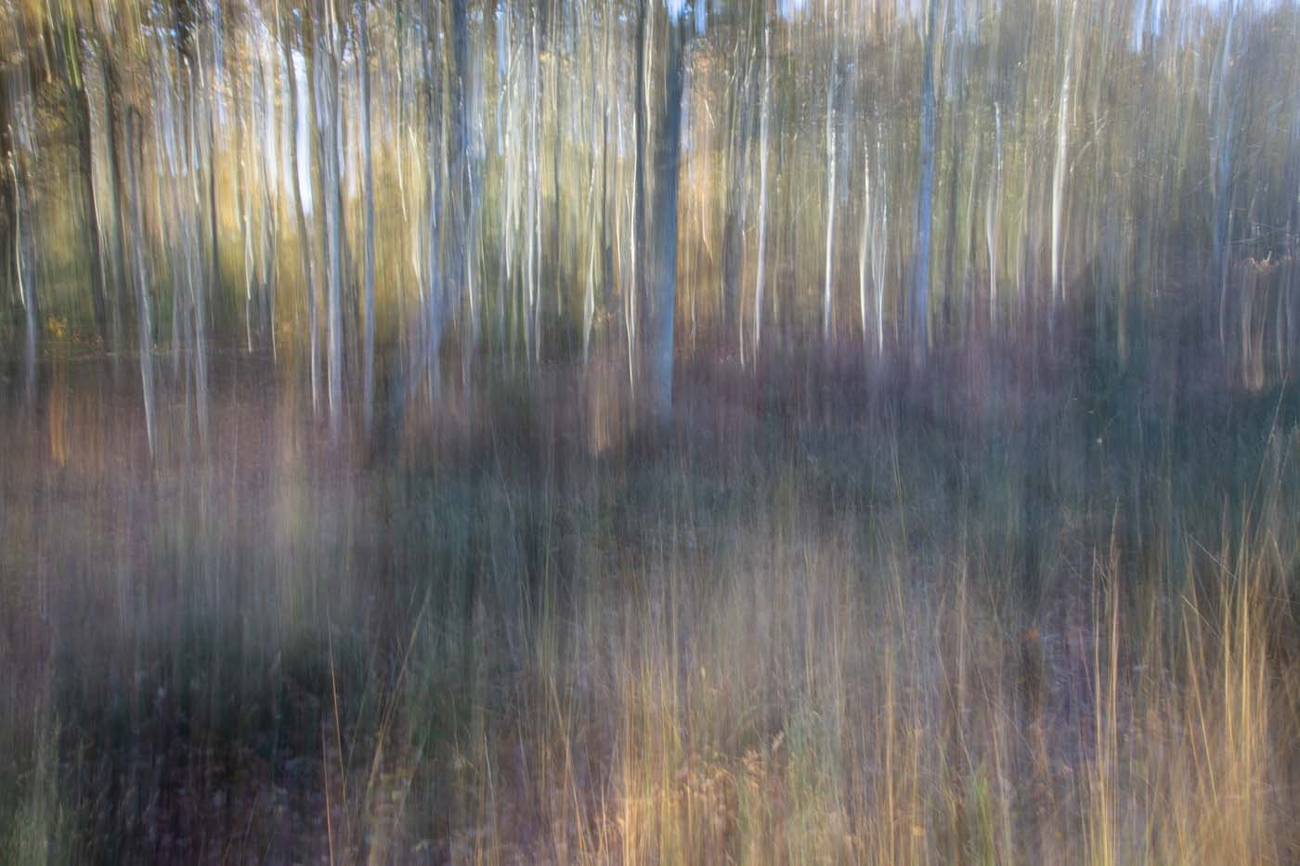
Autumn – Petts Wood (ISO 100, F22 and 1 sec)

Slide 10
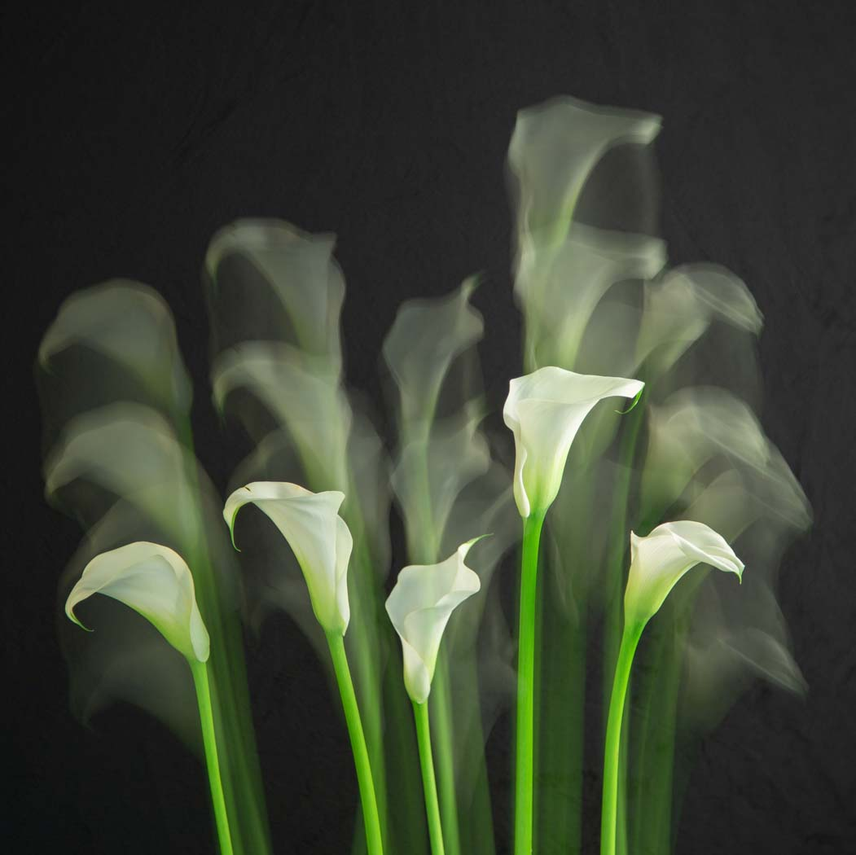
Movement – Lilies (multiple exposures ISO 100, F8 with 2 sec and 0.8 sec)

